Slide 1
Blindfolded NLP:
Unsupervised Learning for Automatically Generating Topic Labels
Charley Wu¹, Zsolt Jurányi², Laszlo Gulyas², George Kampis^{2,3,4}
¹Center for Adaptive Behavior and Cognition, MPI for Human Development
²Petabyte Research Ltd, Budapest
³DFKI (German. Res.Inst. For AI), Kaiserslautern
⁴Eötvös University Budapest

Slide 2
Blindfolded NLP:
Unsupervised Learning for Automatically Generating Topic Labels
Charley Wu¹, Zsolt Jurányi², Laszlo Gulyas², George Kampis^{2,3,4}
¹Center for Adaptive Behavior and Cognition, MPI for Human Development
²Petabyte Research Ltd, Budapest
³DFKI (German. Res.Inst. For AI), Kaiserslautern
⁴Eötvös University Budapest

Slide 3

PetaByte Research Ltd
Big data
Scraping, crawling...
Data analysis, Business analytics
http://petabyte-research.org
http://beta.petabyte-research.org

Slide 4
Bibliometrics, scientometrics
MTA KIK, EMMI (Ministry of Human Aff.), ELTE....
http://www.hungarianscience.org
The present context - IMPACT-EV: SSH
Humanities: not journal papers but...
„Altmetrics“ – books, chapters
National language is important (here: Hungarian)
Full text, so NLP is needed... (here only topic detection is discussed)

Slide 5
Blindfolded NLP
Abstract
The use case of our study is the Hungarian Internet Archive (MIA) pilot, which was used to create a distributional semantic model of the Hungarian language.
Using unsupervised methods, documents from the corpus were grouped into semantically related clusters.
Then topic labels were automatically generated for each cluster by fitting a probability distribution to each cluster. Query vectors were sampled from the probability distribution and used to search the semantic space of the language model to yield the terms with the highest semantic relevance.
This was applied to clusters found using various techniques.
Results are assessed for the applicability of the method for automated semantic labeling and topic detection.

Slide 6
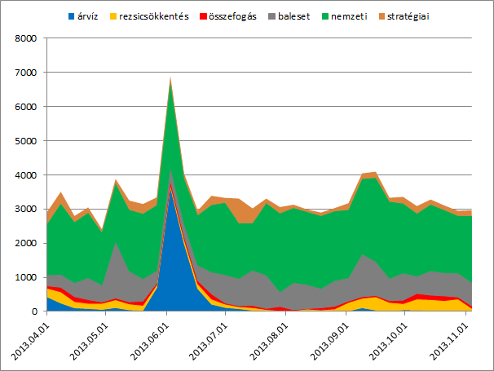
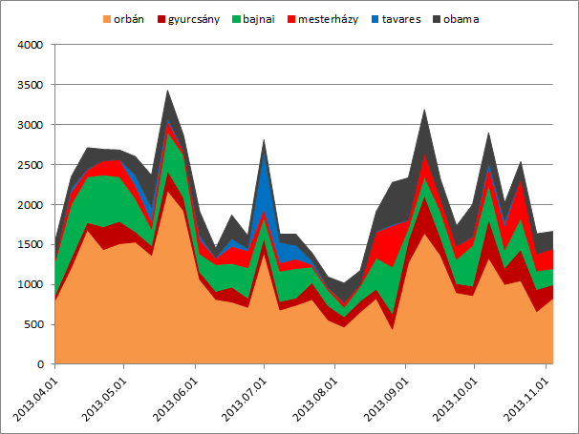
The MIA pilot (and news archive)
500+ domains, 16+ TB, longitudinal since 2013
Hungarian News Archive (of every day)

Slide 7
Basics
The Distributional Hypothesis (Harris, 1954), states that words occurring in similar contexts also tend to have similar meanings
We use unsupervised learning techniques to group the documents into semantically related clusters and to automatically generate topic labels for each cluster by probabilistic sampling.
No expert knowledge, no (subjective) semantics!
(no manual cleaning, etc.)
Massive amounts of data

Slide 8
Corpus, lemmatization
588 days from 2013.04.01 to 2014.11.09.
736,811 different news documents compiled from 589 different online new sites.
The entire dataset contains 193,209,915 total words, of which 2,654,613 are unique words.
This data was lemmatized using the “Magyarlanc” Java library in order to trim the suffixes marking the 18 different grammatical cases in the Hungarian language (Zsibrita et al., 2013).
After lemmatization, the corpus contains 1,197,420 unique words.

Slide 9
word2vec
Using the nGram models to transform the input data, a word2vec model was trained on the Hungarian News corpus.
The model was trained using “trainWord2Vec.py” using the Gensim python library (Řehůřek & Sojka, 2010), which is based on the skip­gram model from Mikolov et al. (2013).
The completed model has a vocabulary of 424,198 terms learned from 736,811 documents.

Slide 10
Then...
....
The vectors were grouped into 588 arrays, with one array per day, where each array is d by 300 dimensions, d is the number of news documents for a given date.
Because of the computational complexity of performing large scale unsupervised learning methods on the entire dataset, clustering methods were first tested on a single days worth of data (specifically 2014.03.01) as a test/demo.
It contained 1,125 different 300­dimensional paragraph vectors, each representing a different news document.

Slide 11
Analysis
Several different clustering methods were explored for the identification of topics.
The main innovation is the use of distributed semantics to cluster the (news) articles, and then autonomously generating topic labels based on a probability distribution fit to each cluster.

Slide 12
Vec2Word
We created a method called “Vec2Word” for searching the word2vec vector space for the n word vectors with the smallest cosine distance to any given query vector v.
The similarity vector that is produced can be easily sorted and used to return the top n words that are most similar to the query

Slide 13
Clustering methods tested
HAC has O(n3)
GMM has a potentially unbounded complexity
  for iterations i and components k, time complexity can be described as O(n * k * i).
DBSCAN is O(n * log n)
  tradeoff for using an indexing structure to reduce the time complexity
  memory complexity is increased from linear to quadratic O(n2) complexity
  it is possible to run DBSCAN either quadratic time and linear memory, or linear time and quadratic memory

Slide 14
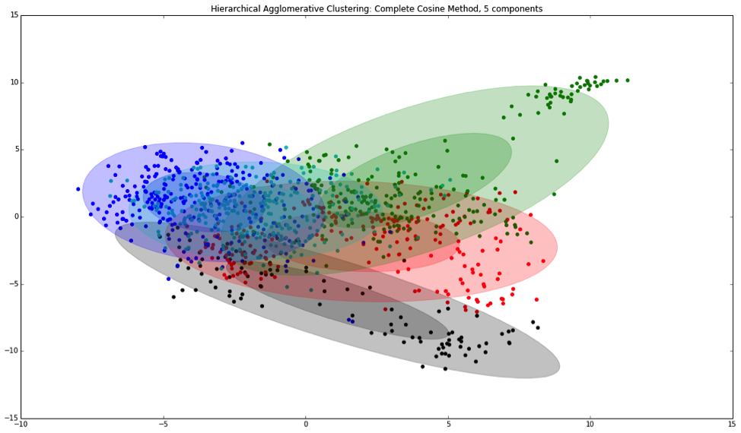
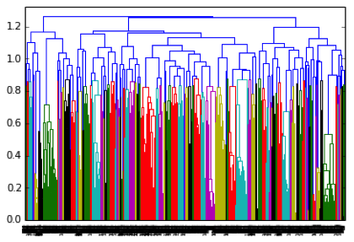
HAC (Hierarchical Agglomerative Clustering)
using cosine distance as the distance metric
L method (Salvador & Chan 2003) for a parameter sweep for final partitions (as HAC needs cluster numbers)
5 viz 57 ☺ clusters
there is no concept of a cluster center in HAC as it uses a dendrogram method
So within­class distance of data points is quite large when compared to between­class distances; overlap of clusters
2D with PCA

Slide 15
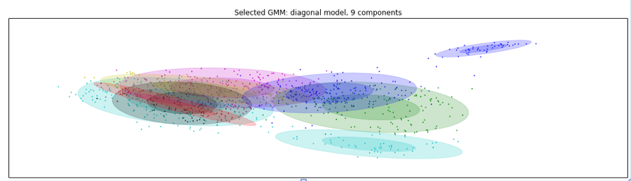
GMM (Gaussian Mixture Models)
Expectation­Maximization algorithm to discover the hidden parameters responsible for the data
the number of clusters needs again to be specified
a parameter sweep to determine the optimal number of clusters
minimize Bayesian Information Criteria (BIC)
However, in our data model BIC was a monotonically decreasing function of the number of components...

Slide 16
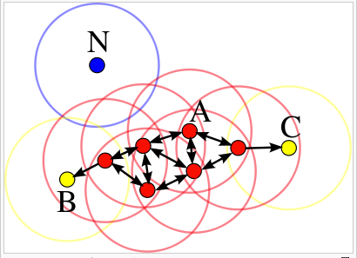
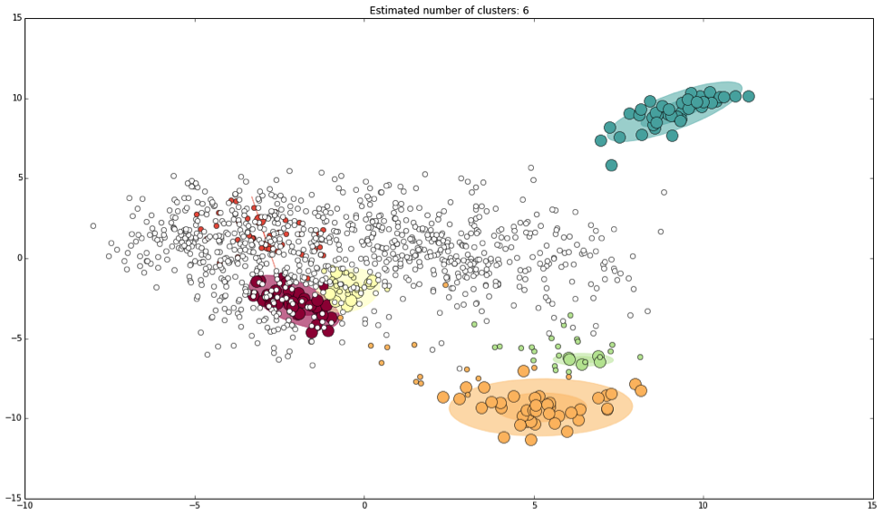
DBSCAN (Density-based spatial clustering of applications with noise )
not necessary to provide the number of clusters
it can discover clusters of arbitrary shape
fast
able to eliminate data noise (N)

Slide 17
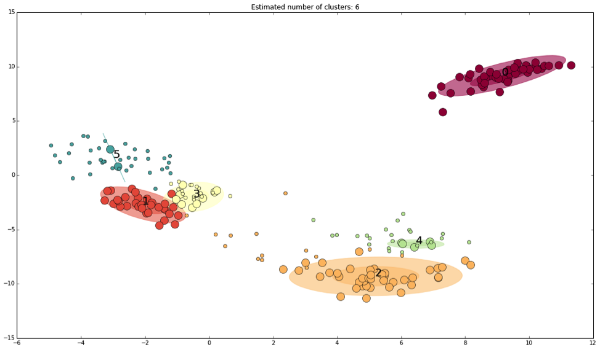
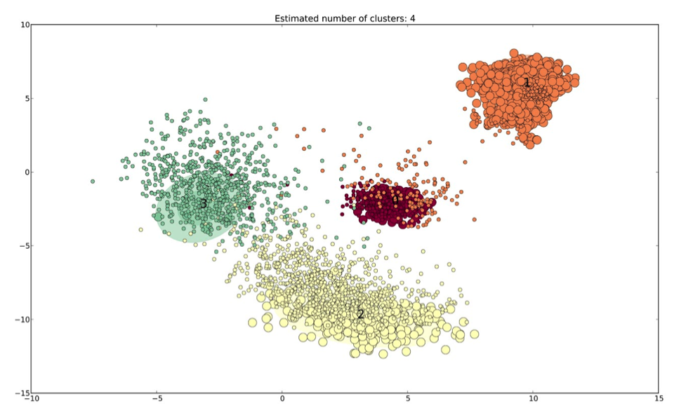
Results (DBSCAN)
much smaller variance than previous methods
very little overlap between clusters.
Used eps = 0.5, minpts = 25, distance = cosine
1 day (5 clusters, 1 month (4 clusters)
2D using PCA

Slide 18

Resulting clusters (DBSCAN) and labels (Vec2Word)
Labels assigned automatically as follows
100 automatically generated topic keywords (including repeats) for each cluster identified using DBSCAN on news articles from 2014.03.01 - 2014.03.31. (1 month)
A Gaussian distribution was fit to each set of core samples for each cluster, and then used to generate 10 query vectors.
Each query vector was used to determine the 10 semantically most related terms found in the word2vec vocabulary.
On this basis, subjectively defined ‘categorization’ of clusters

Slide 19
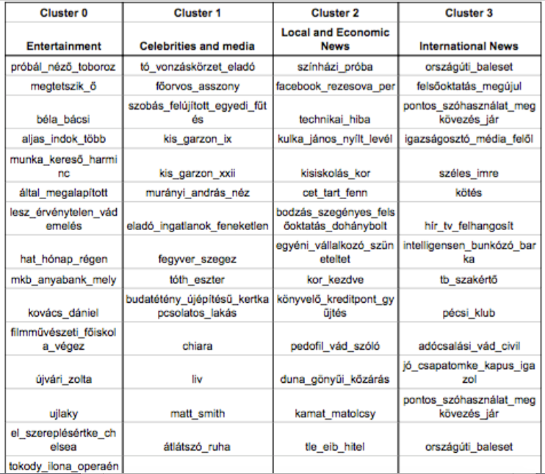
Quality?

Slide 20
So...
This is an area of unsupervised machine learning that could benefit from new clustering approaches
that are capable of operating in both linear time and space complexity.
Convert the problem of topic detection into a weakly supervised learning problem by adapting the method in which data is collected (news have labels ☺).
Is there an objective measure of quality?

Slide 21
Thank you!

